Slide 1

Final Project Data Science – NLP
Neal Xu

Slide 2

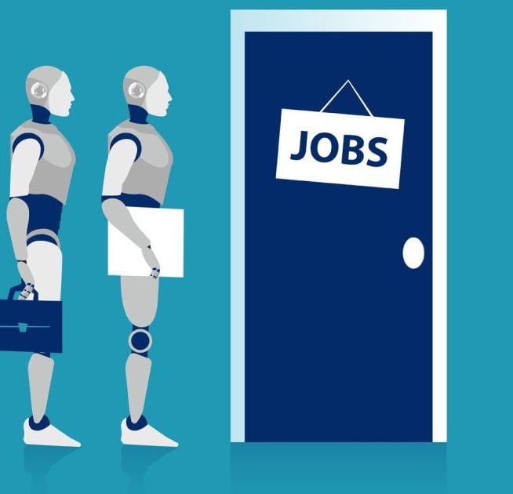
Table of Content
Executive Summary
Source Data Overview
Article Clean-Up and Filtering
Topic Detection
  Methodology
  Summary
Sentiment Analysis
  Methodology & Summary
  Sentiment Over Time
Entity identification – Organizations & People
Targeted Entity Sentiment
Appendix (High Resolution Figures)

Slide 3
Executive Summary
Problem Statement:
This project is designed to identify what types of tasks and jobs are most likely to see the biggest impact from AI by extracting meaningful insights from unstructured text and hereby provide recommendations
Background:
According to a report from Goldman Sachs, specific job categories such as office tasks, legal, architecture, and social sciences have the potential for over 30% automation. This means that a significant portion of tasks within these fields could be automated using AI and other technologies.
Assumption:
Not all jobs will be affected by the AI, positions such as construction, installation, and building maintenance are projected to be largely unaffected by automation. These roles typically involve hands-on work that requires physical presence and manual skills, which are harder to automate using current technologies.

Slide 4
Executive Summary – Continued
Findings
Actionable recommendations
The recommendation about what can be done with AI to automate jobs and/or improve employee productivity. Companies looking to invest in data science initiatives today or in the near future focus on industries where AI has demonstrated success and significant potential.
Technical companies, in particular, can benefit from investing in data science AI initiatives due to advantages such as competitive advantage, enhanced decision-making, improved customer experience, higher operational efficiency, cost reduction, innovation, and new revenue streams.
However, it is crucial to still consider the limitations of AI in certain industries and prioritize areas where human expertise is indispensable or where AI may not yet have reached its full potential. Such as the stock market and agriculture.
Most of news article has a slightly positive tongue when talking about jobs and data science AI Technology. While AI technology has shown significant advancements in most industries and positive sentiment overall, there are certain types of applications that currently face limitations in terms of AI transformation based on the news analyzed in this project.
Two industries that stand out are stock market analysis and agriculture. In stock market analysis, factors such as quarter results, ETFs, and stock prices still heavily rely on human decision-making, making it challenging for AI to accurately predict and transform this domain. Similarly, the agriculture industry requires an understanding of growth analysis, revenue, key players, or the actual labor which makes it difficult for AI to fully transform this sector.

Slide 5
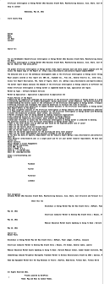

Source data overview
In this project, there are 200,000 unstructured news articles along with additional information such as URL, date, language, title, and text.
WHY?
It is important to remove irrelevant words before we do any additional analysis such as topic modeling and sentiment analysis.
HOW?
The method used to remove the irrelevant chunk is by utilizing punctuations.
A news text will have [. ! ? ; ,] as a punctuation at most every 60-100 words.
But for most unwanted text are not separated by [. ! ? ; ,]
So, we split text by [. ! ? ; ,] and remove item with more then 400 characters in it to clean chunks.
Needed news text
Unwanted Text
TO
Actual News Text
Unwanted Text
e.g., There is no [. ! ? ; ,] in this text chunk.

Slide 6
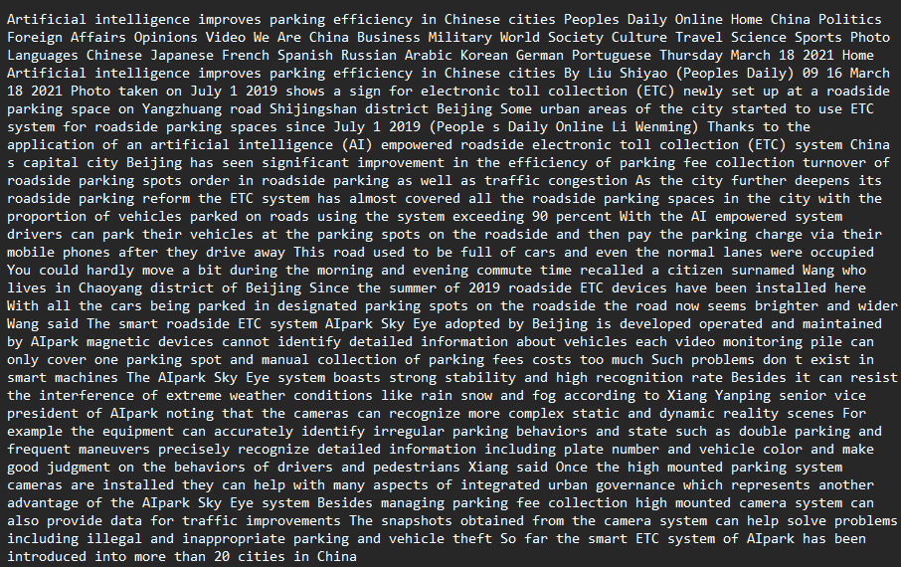
Article clean-up and filtering
Example of Cleaned New Text by following the Steps on the right-hand side:
Steps of texting cleaning:
Remove newlines, tabs, \r, \n.
Remove URLs, emails, phone numbers, special characters, and other unwanted elements.
Split the text into sentences using punctuation marks.
Remove irrelevant chunks or sections that are not necessary for analysis.
Filter out rows or articles that do not contain keywords from a customized list related to AI tech and jobs.
Tokenize the text by splitting it into individual words and remove punctuation.
Remove common stopwords (e.g., articles, prepositions, conjunctions).
Generate n-grams (word sequences) to capture contextual information if needed.
Lemmatize words to their base or root form.
Ready for Modeling!

Slide 7
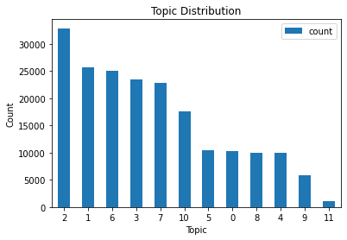
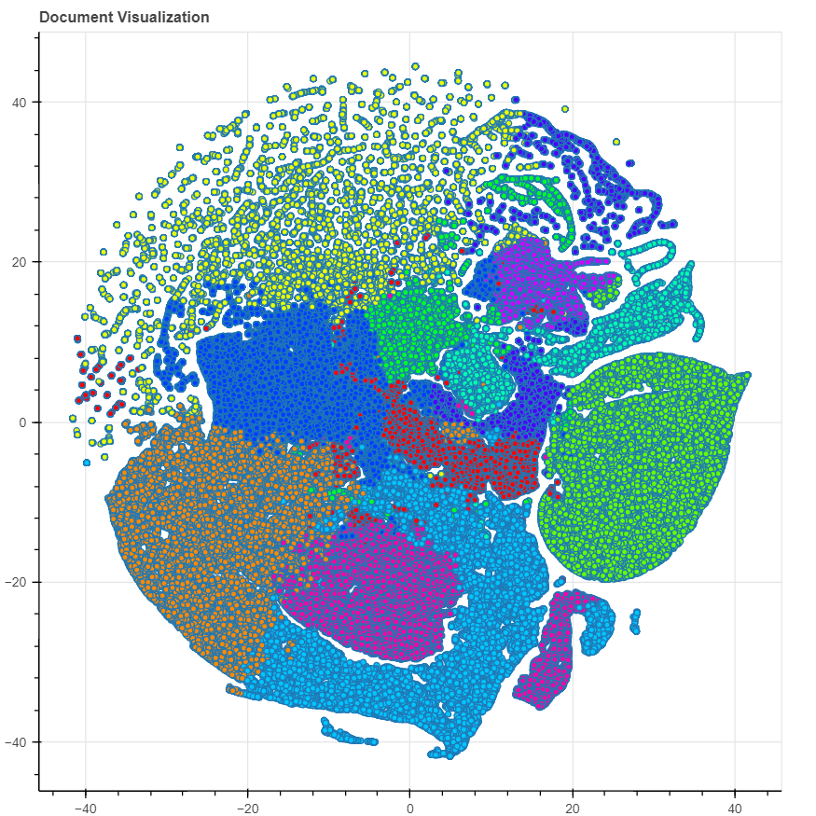
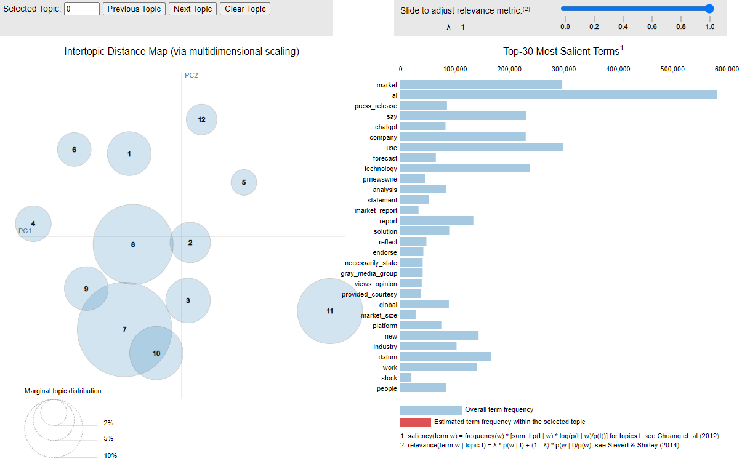
Topic detection (Methodology)
This graph illustrates the topic distribution for K-Train:
For the Topic detection, LDA using the genism package was first applied with hyperparameter tuning to find out the best choice of a number of topics is 12 with the best combination of topic overlap and coherence score of 0.434649.
Figure. 1
K-train Topic (Left) and Genism (Right) illustrate the acceptable topic overlaps.
Figure. 2
Figure. 3

Slide 8
Topics Detection
(K-train)
Main Topics:
Press release distribution and content solutions
Human-like methods used to work with images.
Analysis of global markets, growth forecasts, industry research, and key players.
Use of machine learning by security companies for managing digital information.
Advancements in language technology by ChatGPT, Google, Microsoft, OpenAI, and others.
Insights into stock shares, investment, market outlook, prices, and NASDAQ.
Research, education, and student involvement in machine learning and computer science.
Application of AI in healthcare, including medical care, patient management, cancer treatment, drug development, and medical imaging.
Benefits and performance optimization of edge computing, NVIDIA technology, and smart devices.
Cloud services, energy-related technologies, software solutions, and global companies like IBM and Amazon.
The topics on the left hand cover various main topics in the field of technology and business. It covers press release distribution, human-like image processing, global market analysis, machine learning in security, advancements in language technology, stock market insights, research in machine learning and computer science, AI in healthcare, edge computing and smart devices, and cloud services by companies like IBM and Amazon.

Slide 9
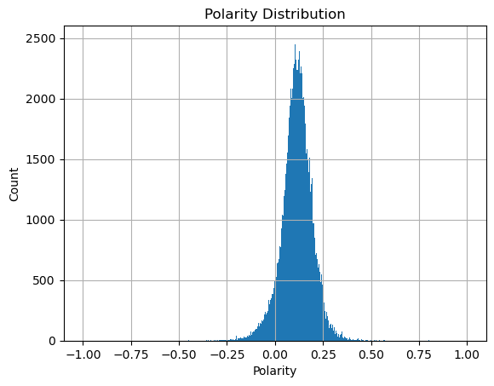
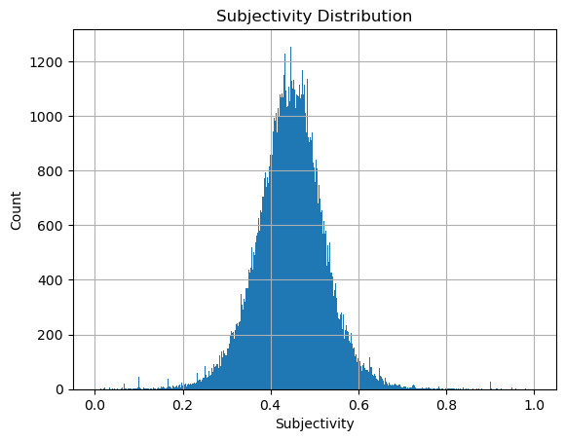
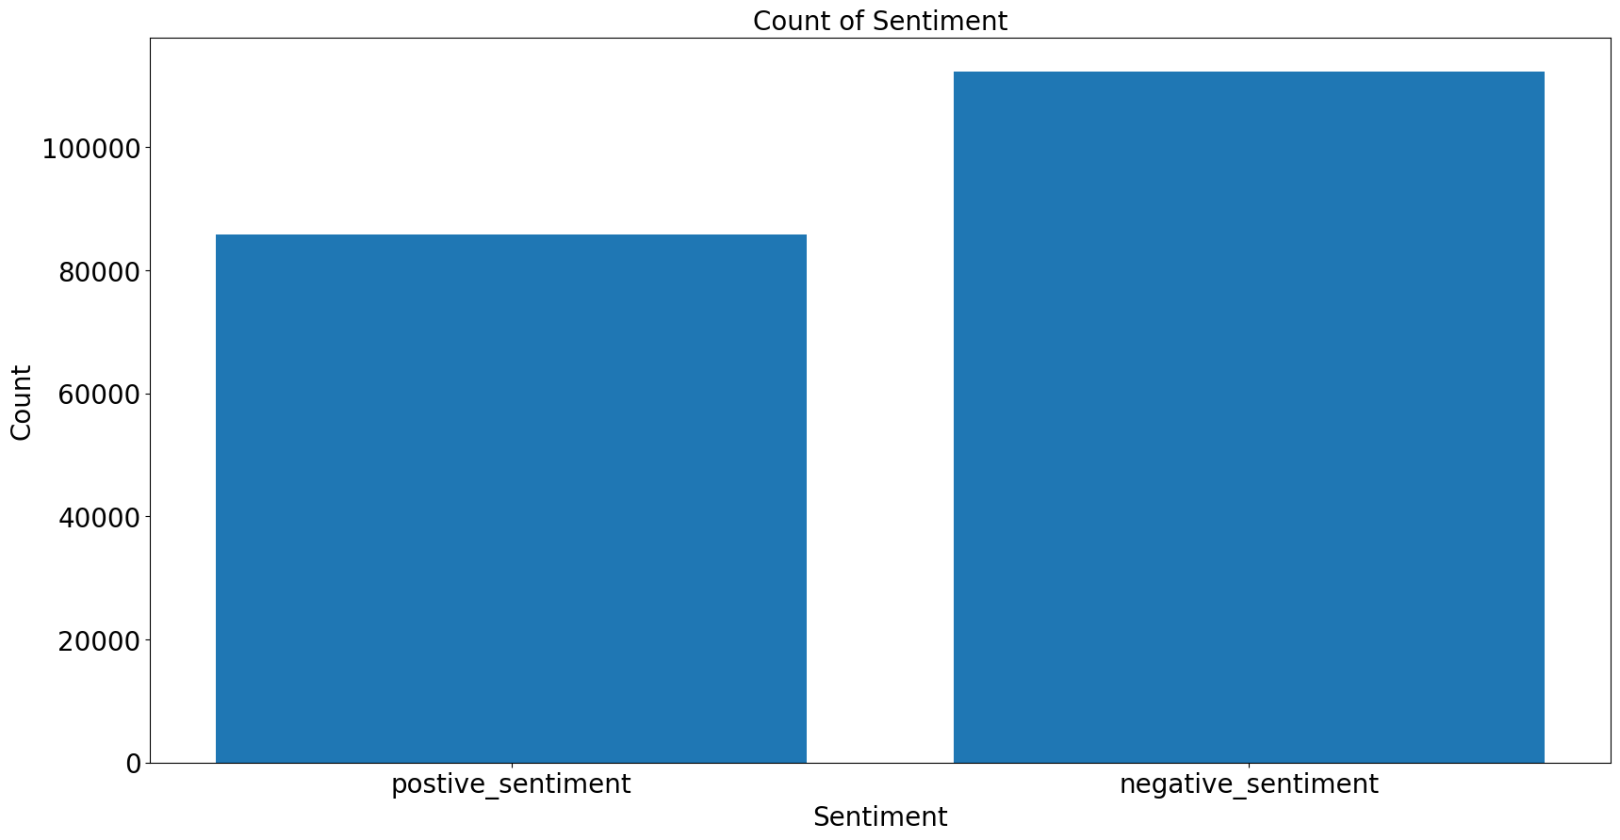
Sentiment Analysis (Methodology)
-- Using a combination of Transformer + TextBlob
The absence of a pre-trained model tailored to sentiment analysis of news articles pertaining to AI technology and jobs presents a significant challenge. Furthermore, the impracticability of human labeling due to the substantial volume of labels required exacerbates the problem. In light of these limitations, this study proposes a novel methodology that integrates TextBlob and a transformer model sourced from Hugging Face, incorporating a total of 215 sentiment analysis models. Leveraging the polarity and subjectivity metrics provided by TextBlob, the accuracy of the model's predictions is assessed. Remarkably, the findings demonstrate a high degree of congruence and accuracy between the combined approach and TextBlob's results. To enhance the validity of the outcomes, a random sample of 50 news articles was selected, and the sentiment analysis generated by the model was compared against human judgments, yielding consistent and accurate outcomes.
Figure. 4
Figure. 5
Figure. 6
Transformer
TextBlob
TextBlob

Slide 10
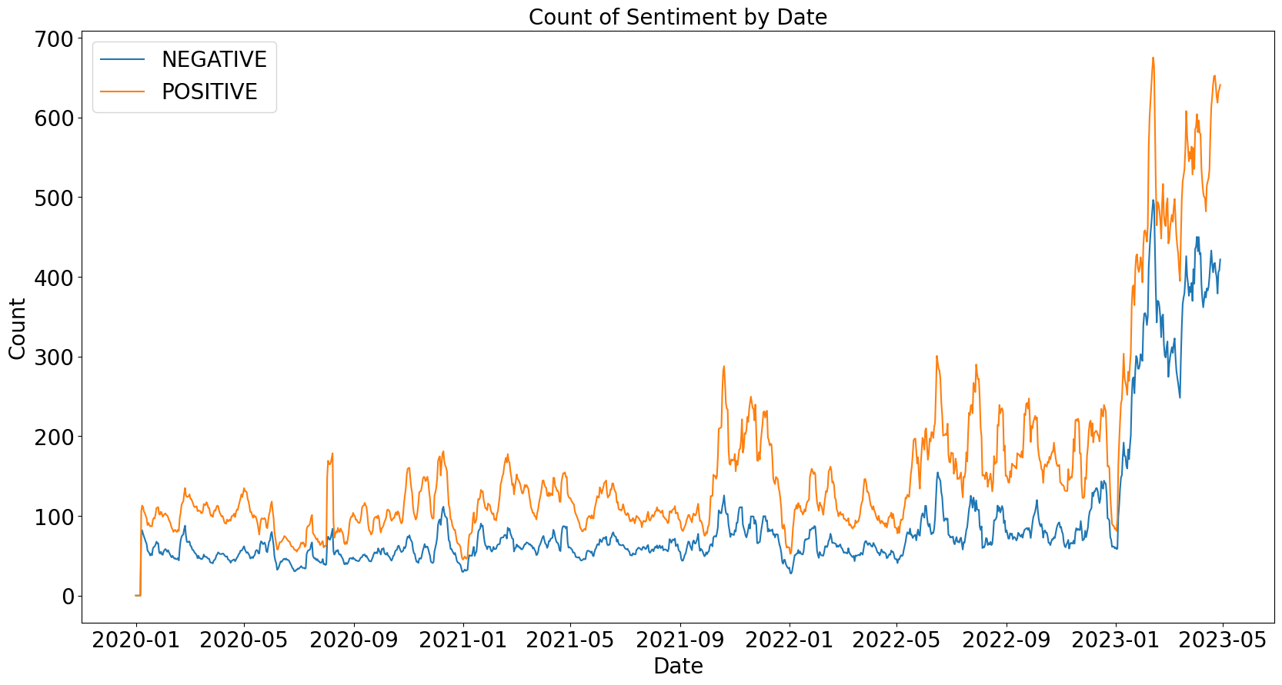
Sentiment over time analysis and visualization
On the left, you can observe the overall sentiment towards AI technology over time. It is evident that the positive sentiment has consistently remained higher than the negative sentiment for the majority of the duration.
However, starting in January 2023, there was a noticeable increase in both positive and negative sentiments. One possible reason for this shift could be attributed to the launch of ChatGPT 3.5 in November 2022, which gained significant attention from the public by January 2023. As people became more aware of the advancements in AI technology, it sparked both positive and negative reactions.
(Note: This analysis excludes sentiments close to neutral, where the subjectivity score is near 0.)

Slide 11
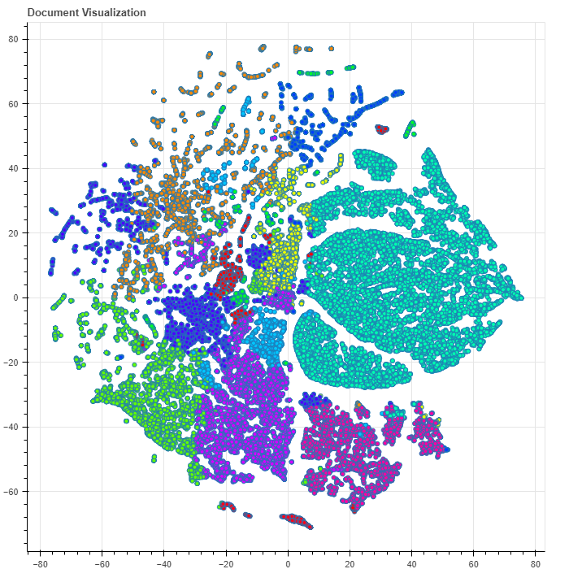
Sentiment Analysis:
Q: Why do certain types of applications succeed, and others failed?
A: To answer, K-train topic modeling is used twice for both succeed and failed news articles for answer:
Successful AI, data science, and tech applications:
Improved user experience (Topic 8)
Reliable news and information (Topic 3)
Market analysis and research (Topic 7)
Cloud solutions and customer service (Topic 11)
Advancements in healthcare (Topic 2)
Failed AI, data science, and tech applications:
Privacy and legal concerns (Topic 0)
Ineffective work and education solutions (Topic 1)
Inadequate healthcare solutions (Topic 2)
Biased or inaccurate media (Topic 3)
Inadequate hardware and software solutions (Topic 4)

Slide 12
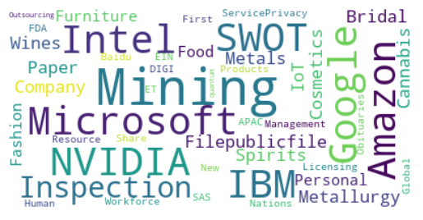
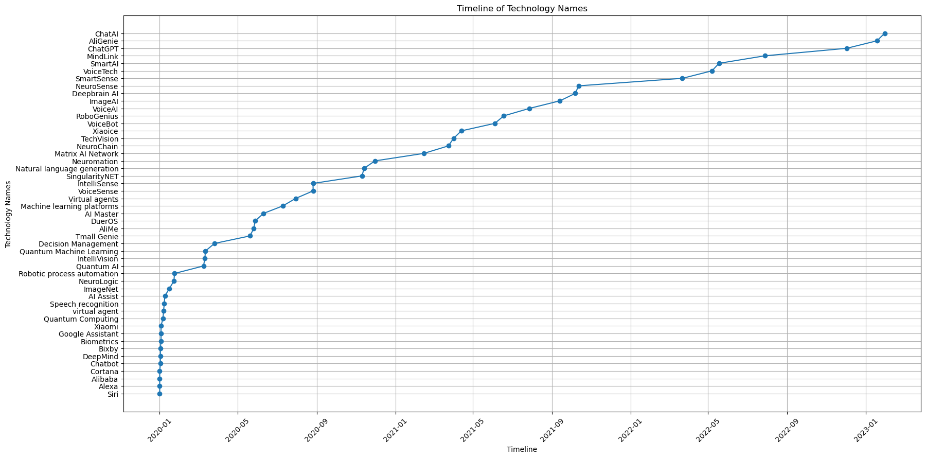
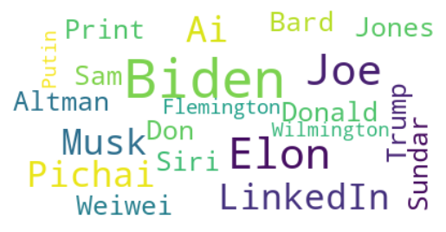
Entity identification
– Technology, Organizations & People
Note: These organizations have overall !!!POSITIVE!!! sentiments toward AI technology
Figure. 8 (Organization)
Figure. 8 and Figure. 9 on the lefthand are two Word Clouds depict the most commonly mentioned organizations and persons by utilizing spaCy. In the organization Word Cloud, it is noticeable that it includes both companies and some AI applications. Among the frequently mentioned companies, a majority of them are technology-focused. Regarding individuals, Elon Musk, the CEO of Tesla, Sam Altman, the CEO of OpenAI, and President Biden are prominent figures in this word cloud. This occurrence is likely due to their close involvement with the development and regulation of AI applications.
Figure .7 below is a timeline for the introduction of the new technology and AI solutions that might be affecting the landscape of data science applications, the most frequently mentioned are ChatGPT, Biometrics, Chatbot, Alexa, DeepMind, Alibaba, Deepbrain AI, AI Assist, Quantum Computing, Siri, Xiaomi, Quantum, and Virtual Agent.
Figure. 7
Figure. 9 (Persons)

Slide 13
Continue:
Targeted (entity) sentiment identification
Q: What types of companies should invest in data science initiatives today or near future?
A: As shown in Figure. 8 which has companies that generally have positive sentiments in the news article, technical companies should invest in data science Ai initiatives today or near future.
It is intuitive since there are such advantages for them as shown:
Competitive Advantage
Enhanced Decision Making
Improved Customer Experience:
Higher Operational Efficiency
Cost Reduction
Innovation and New Revenue Streams
Future-Proofing
Figure. 8 (Organization)

Slide 14
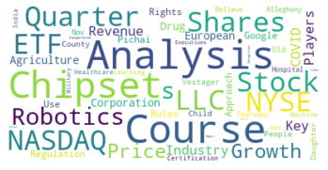
Continue:
Targeted (entity) sentiment identification
Q: What types of applications cannot currently be transformed by AI, based on today's state of technology (failures)?
A:
Stock Market Analysis (MOST Mentioned as shown in Figure.9): While AI has been used in analyzing stock market trends, factors such as quarter results, ETFs, and stock prices are still predominantly influenced by human decision-making. The complexities of the stock market make it challenging for AI to accurately predict and transform this domain.
Agriculture Industry: Although there have been advancements in using AI for agriculture, there are still limitations. Factors such as growth analysis, revenue, and key players in the industry require a deep understanding of the agriculture sector, making it difficult for AI to fully transform this industry.
The industry below are less mentioned (For more information, refer to appendix page 25):
News and Politics: AI can assist in providing news and information, but understanding nuanced topics like politics, public opinion, and regulations can be challenging. Issues related to regulation, European rules, and the approach of companies like Google may require human judgment and interpretation.
Healthcare Education: While AI has been used in healthcare for various applications, certain aspects, such as certification courses, executive-level training, and online learning, may require human expertise, especially when it comes to providing personalized education and understanding complex medical scenarios.
Military and Transportation: The analysis of military strategies, transportation systems, video recognition, and chipsets for military use requires highly specialized knowledge and expertise. AI may have limitations in fully transforming these domains due to the complexity and sensitivity of the subject matter.
Figure. 9 Negative Application Sentiment
This targeted word cloud was created by focusing on negative sentiment. The topic modeling technique was used for identifying keywords associated with failures, and the sentiment was adjusted accordingly to present the final results.

Slide 15


Slide 16
Appendix
Page 16 – Page 25

Slide 17
Figure. 1

Slide 18
Figure .2

Slide 19
Figure. 3

Slide 20
Figure. 4
Transformer

Slide 21
Figure.5 and Figure. 6
Figure. 5
Figure. 6
TextBlob
TextBlob

Slide 22
Table. 1 (Detailed topic summarization)
Based on the information you provided, it seems that the topics trained by ktrain on your dataset of news articles related to Data Science, Machine Learning, and Artificial Intelligence are as follows:
Topic: Gray Media Group PRNewswire Platform Press Release Content Solutions Customers | Count: 32,868
  This topic seems to be related to press releases and content solutions provided by Gray Media Group's PRNewswire platform for its customers.
Topic: People Making Way Images Work Using Human-like Methods | Count: 25,749
  This topic focuses on how people employ human-like methods to work with images.
Topic: Global Market Analysis, Growth Forecast, Industry Research, Key Players | Count: 23,469
  This topic involves market analysis, growth forecasts, industry research, and discussions about key players in the field.
Topic: Security Companies Utilizing Machine Learning Systems to Help with Digital Information | Count: 22,793
  This topic explores how security companies are utilizing machine learning systems to assist with managing digital information.
Topic: ChatGPT, Google, Microsoft, OpenAI, Search, Chatbot, GPT, Language Tech | Count: 17,603
  This topic covers discussions about ChatGPT, Google, Microsoft, OpenAI, search engines, chatbots, GPT models, and language technology.
Topic: Stock Shares, Investment, Market Outlook, Price, NASDAQ | Count: 10,430
  This topic revolves around discussions related to stock shares, investments, market outlook, prices, and NASDAQ.
Topic: Machine Learning Research, Education, Students, University, Computer Science | Count: 10,292
  This topic focuses on machine learning research, education, students, universities, and computer science.
Topic: Healthcare, Medical Care, Patients, Clinical, Cancer, Drug, Imaging | Count: 9,967
  This topic involves discussions related to healthcare, medical care, patients, clinical practices, cancer treatments, drugs, and medical imaging.
Topic: Edge Computing, NVIDIA, Smart Devices, Performance, Software, Hardware | Count: 9,938
  This topic explores edge computing, NVIDIA technology, smart devices, performance optimization, software, and hardware.
Topic: Republic, Email Policy, Travel, Password, Sports, American Services | Count: 5,837
  This topic covers discussions related to republics, email policies, travel, passwords, sports, and American services.
Topic: Cloud Services, Energy, Software, Global, IBM, Amazon, Supply | Count: 1,055
  This topic involves discussions about cloud services, energy-related topics, software, global perspectives, IBM, Amazon, and supply chains.
These topics provide an overview of the major themes present in your dataset, covering a range of subjects related to data science, machine learning, artificial intelligence, and their potential impacts on various industries and domains.

Slide 23
Figure. 7

Slide 24
Table. 2 (Topics for sentiment analysis)
topic:5 | count:13131 | report analysis forecast key players trends size opportunities revenue software
topic:9 | count:4714 | said chatgpt year tech microsoft india policy privacy students use
topic:1 | count:4545 | gray media prnewswire nvidia press release solutions platform statements said
topic:3 | count:4101 | like video users time language google search best use people
topic:8 | count:3628 | customer cloud platform digital customers solutions service experience conversational security
topic:10 | count:3122 | policy travel public american transportation aviation sports real mining beverages
topic:2 | count:1822 | health healthcare clinical care medicine ein patient medical patients presswire
topic:7 | count:1365 | medical imaging healthcare radiology cancer clinical patients gray patient lunit
topic:6 | count:1351 | learning machine science platform analytics education models cloud use model
topic:0 | count:923 | edge smart iot digi communications devices hardware power chip software
topic:4 | count:880 | vision computer health recognition robots robotics conference university people awards
topic:11 | count:302 | let state work union people great americans make address society

Slide 25
Table. 3 (In substitute to Slide No. 14)
topic:4 | count:1643 | analysis growth forecast industry key trends size players software application
topic:0 | count:1322 | chatgpt said google microsoft openai privacy people use users bard
topic:9 | count:509 | shares stock nasdaq quarter etf llc nyse robotics holdings price
topic:8 | count:300 | analysis growth industry revenue covid key players agriculture corporation drug
topic:5 | count:180 | said google jones state trump told june like department advertisement
topic:1 | count:116 | chatgpt public asked online false chatbot facebook twitter said published
topic:6 | count:110 | state type avatar u0438 comment typestr contentid likedata withusers subsite
topic:7 | count:88 | said european regulation approach use rules rights pichai google vestager
topic:11 | count:34 | people county child daughter old hospital allegheny thursday believe nov
topic:10 | count:32 | oil gas ibm saudi speaker center arabia agreement media national
topic:3 | count:20 | course healthcare learning india machine courses certification executives jobs online
topic:2 | count:14 | military transportation analysis recognition video china years world chipsets chipset

